Slide 1
Attrition and Income analysis
Bo Yun

Slide 2
Data description and goal
870 # employee data in the Training set
300 # employee data in the Competition set(No attrition provided)
300 # employee data in the Validation set(No salary provided)
Prediction of Attrition classification on No attrition set
Prediction of Salary on No salary data (RMSE <$3000)

Slide 3
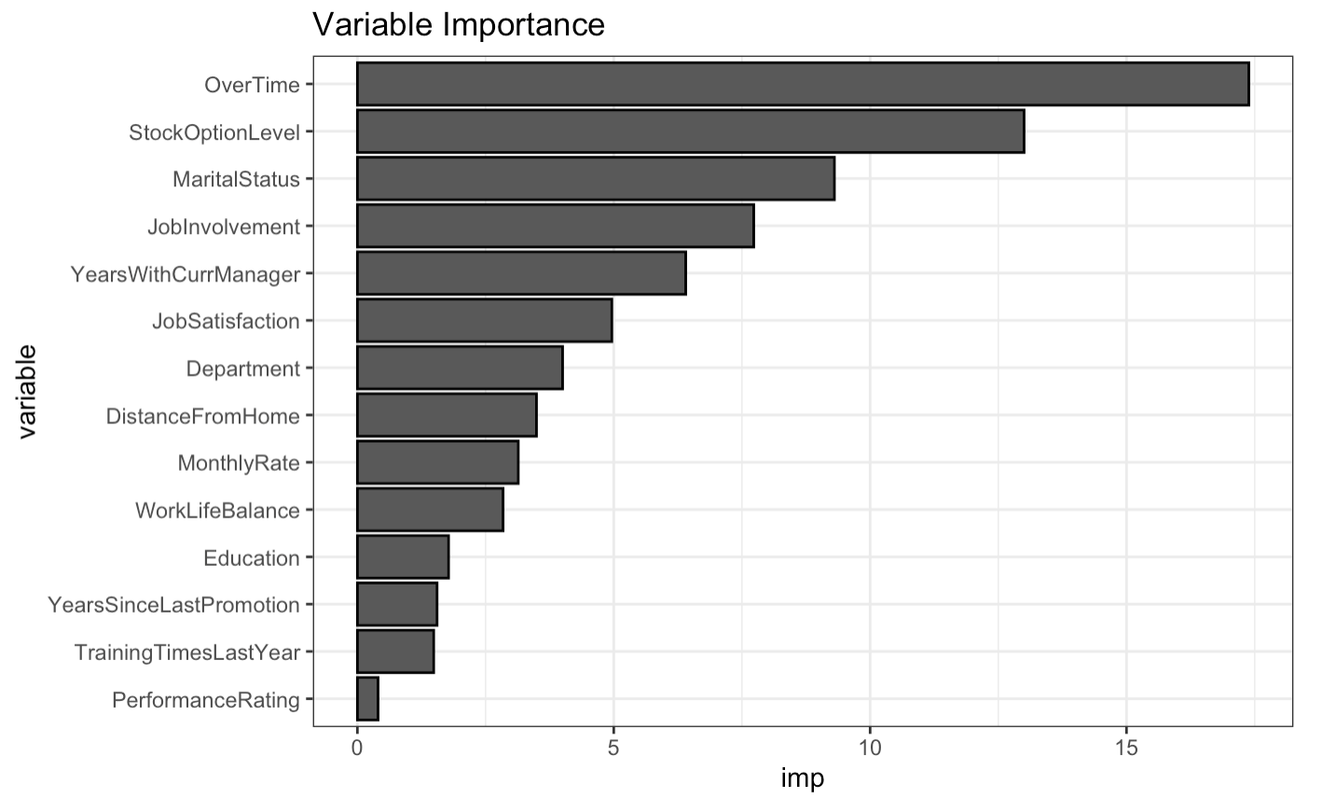
Attrition - Variable selection
Recursive Partitioning regression
Top 3 :
Over Time
Stock Option Level
Marital Status

Slide 4
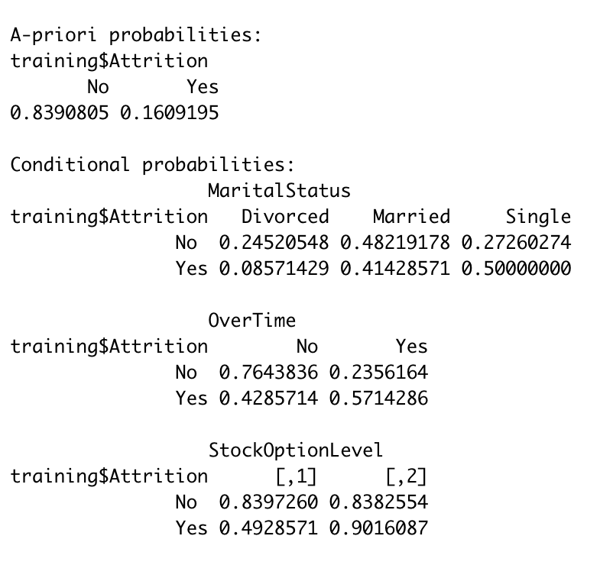
Attrition - top contributors
Naïve Bayes model
Majority of the employees (84%) stays with the company.
Marital status
Overtime
Stock option level

Slide 5
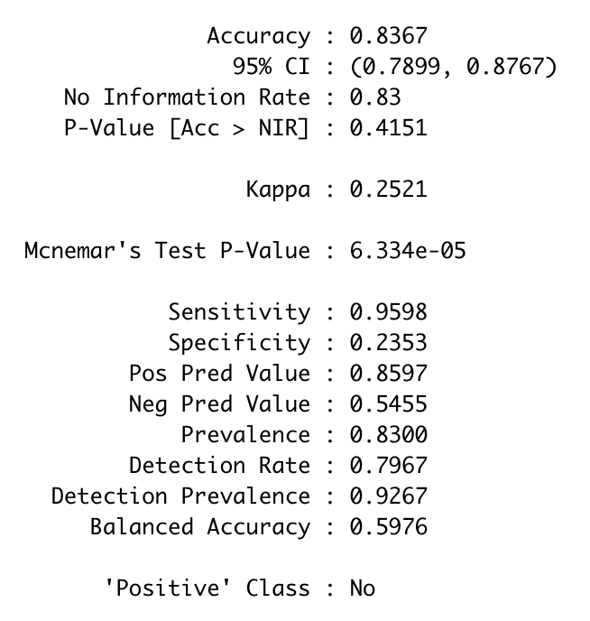
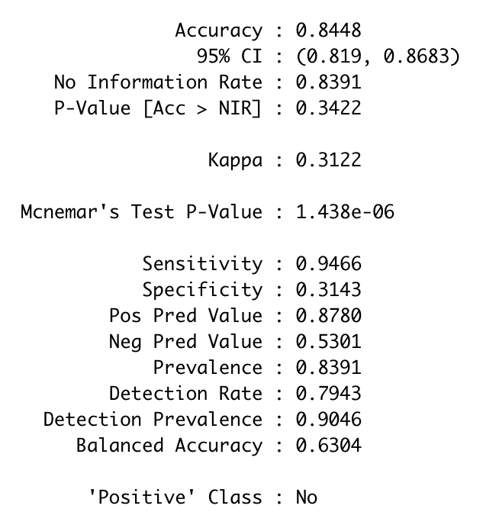
Attrition - Naïve Bayes model testing
Validation set (No Salary set)
Training set
Both Validation and training set show fairly similar result
Accuracy: 0.84
Sensitivity : 0.95
Specificity : 0.25~0.31
=> Low specificity means false positives.

Slide 6
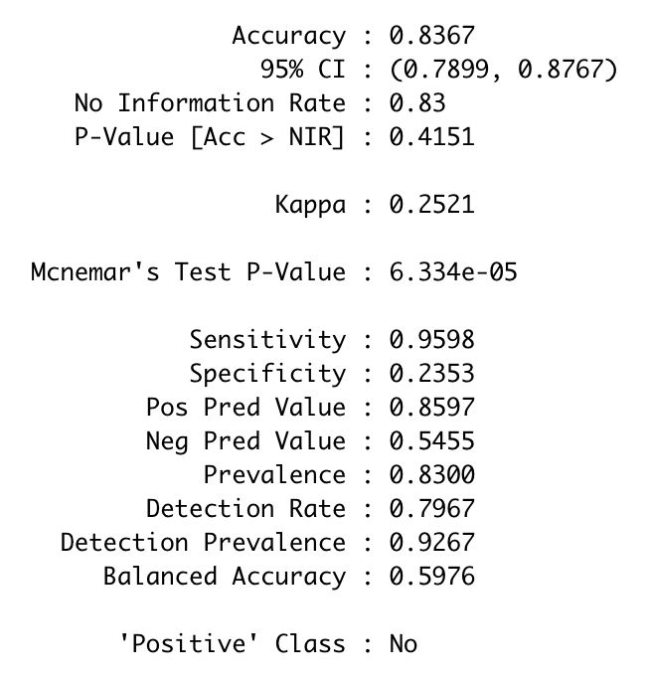
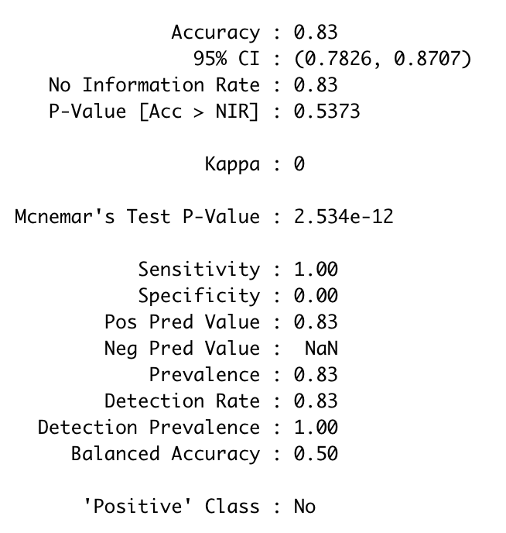
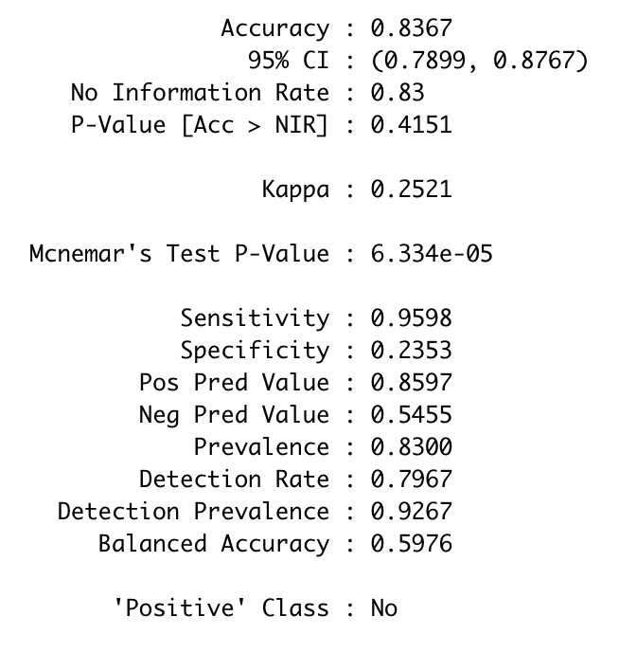
Attrition - Exploring other models
Random Forest on Validation set
Support Vector Machine (SVM)
Linear Discriminant Analysis (LDA)

Slide 7
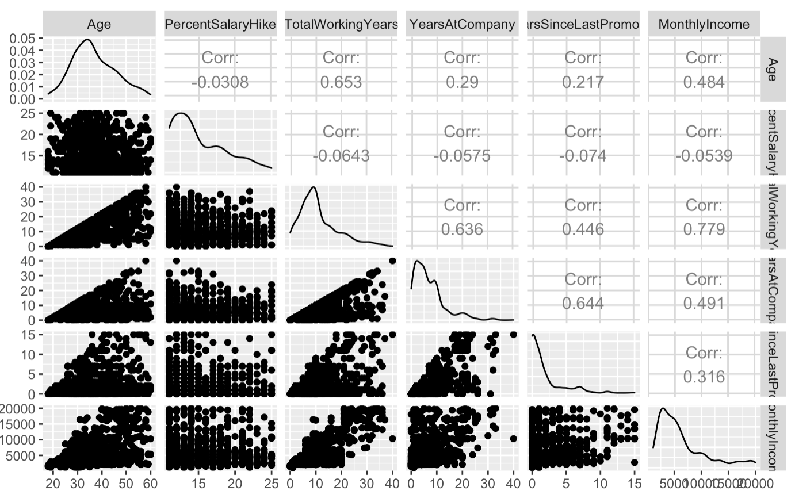
Income analysis – Variable selection
Continuous Variable selection
Several variables were manually selected based on intuitively assumed relationship with Income.
TotalWorkingYears and YearsAtCompany are selected based on their linear relationship with Income from the scatterplot.

Slide 8
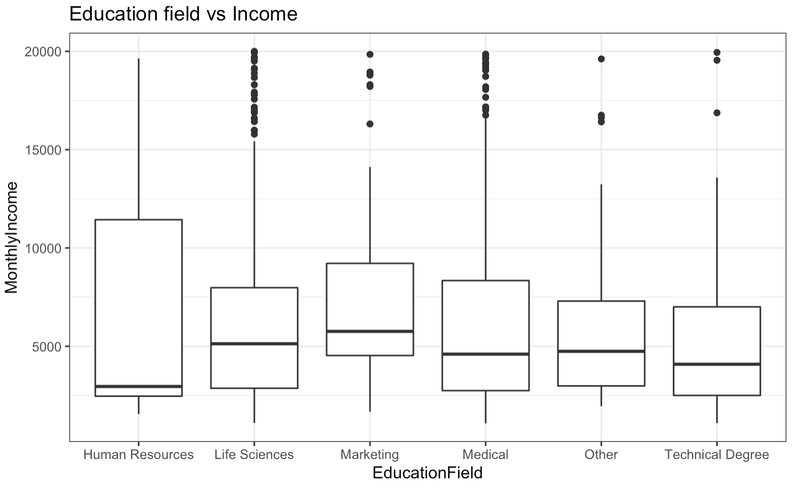
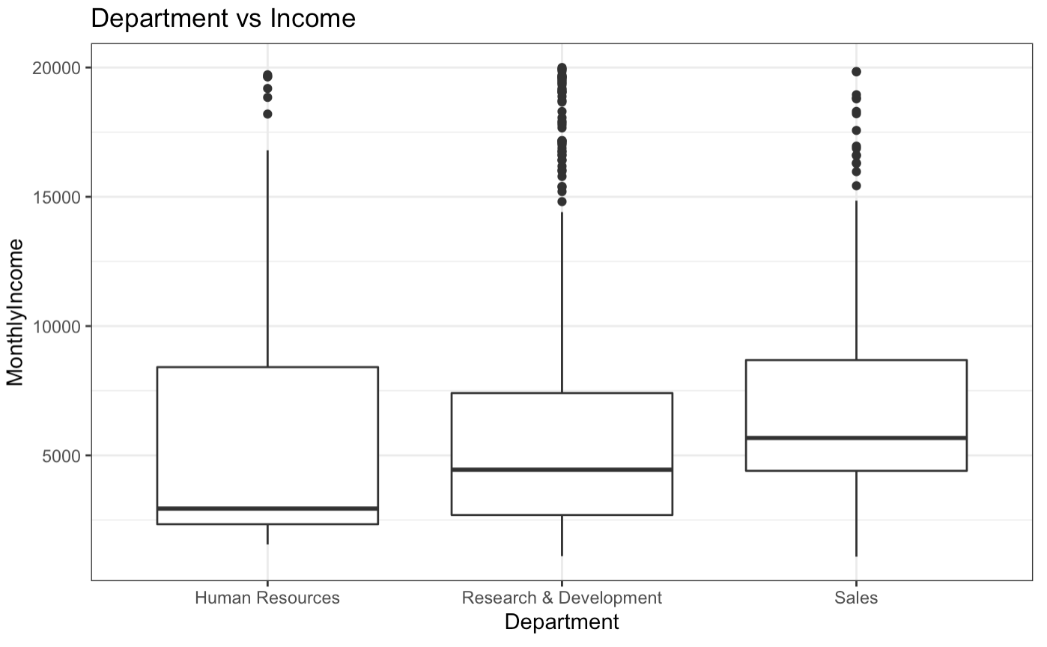
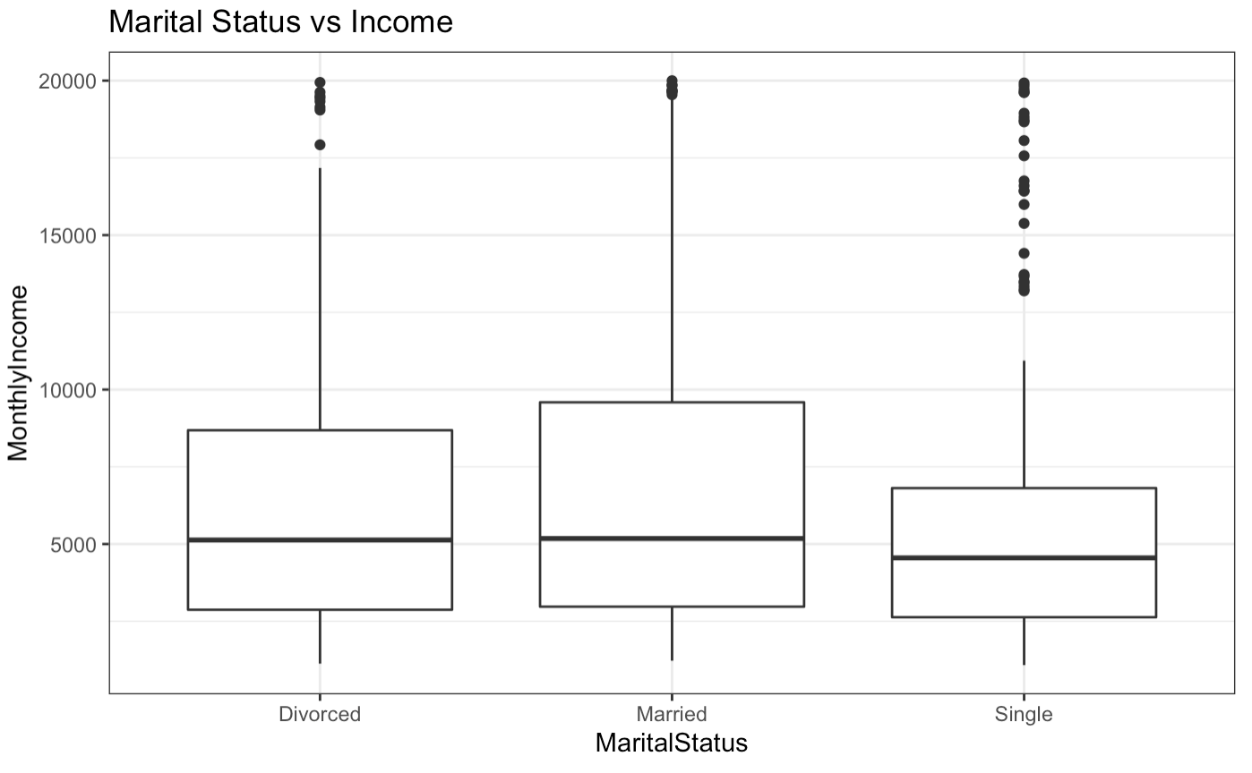
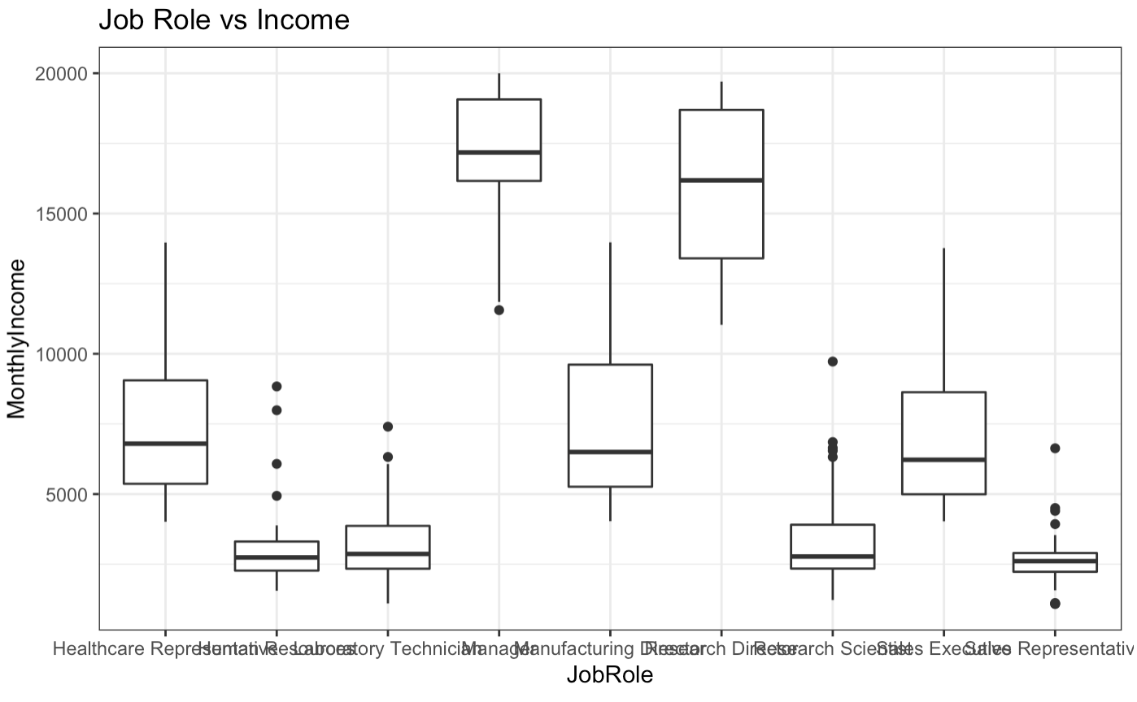
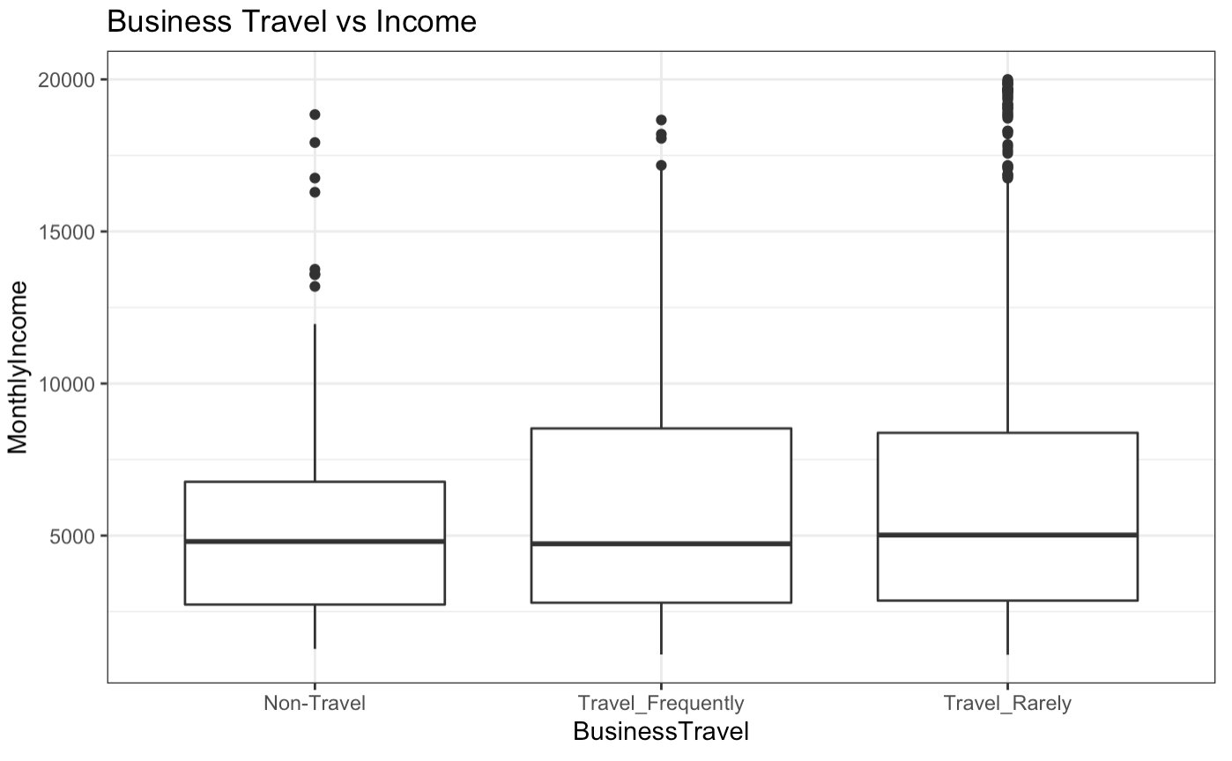
Income analysis – Variable selection
Categorical Variable selection

Slide 9
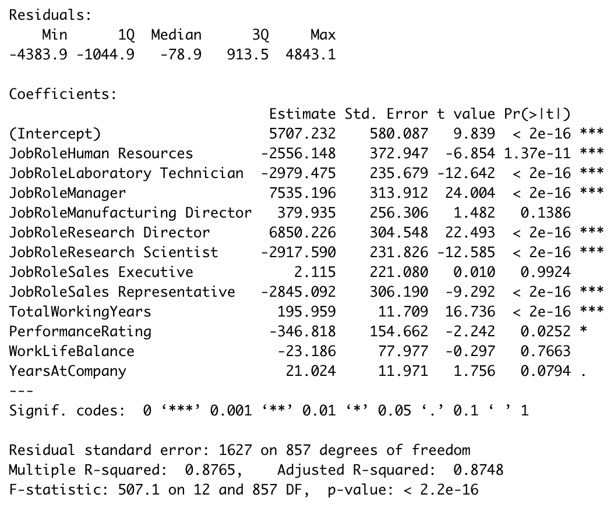
Income analysis – Variable selection
RMSE on Test set: 65.9418

Slide 10
Conclusion
Specificity for the Attrition rate result was low for all models (lots of false positives)
-> Data needs further investigation
Predicting Income using multilinear regression worked very well, RMSE <100

